Slide 1
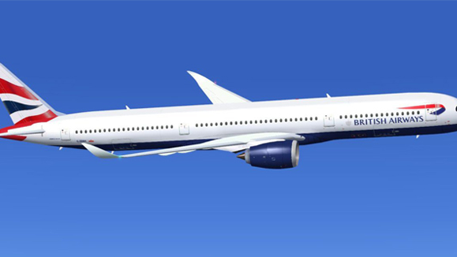
BRITISH AIRWAYS
Web Scraping To Gain Company Insights

Slide 2
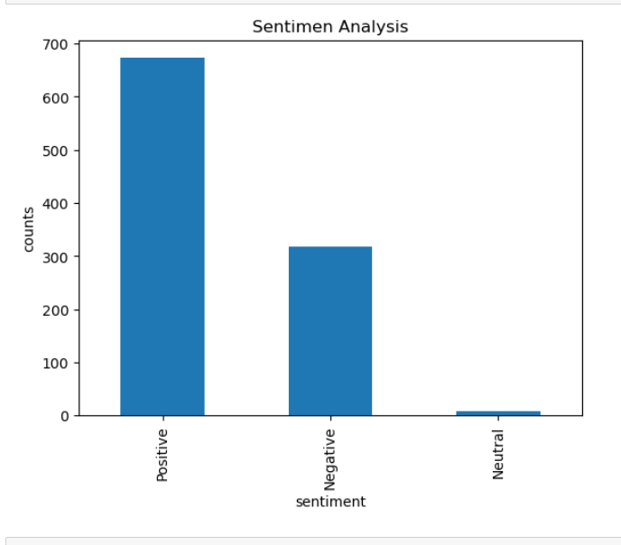
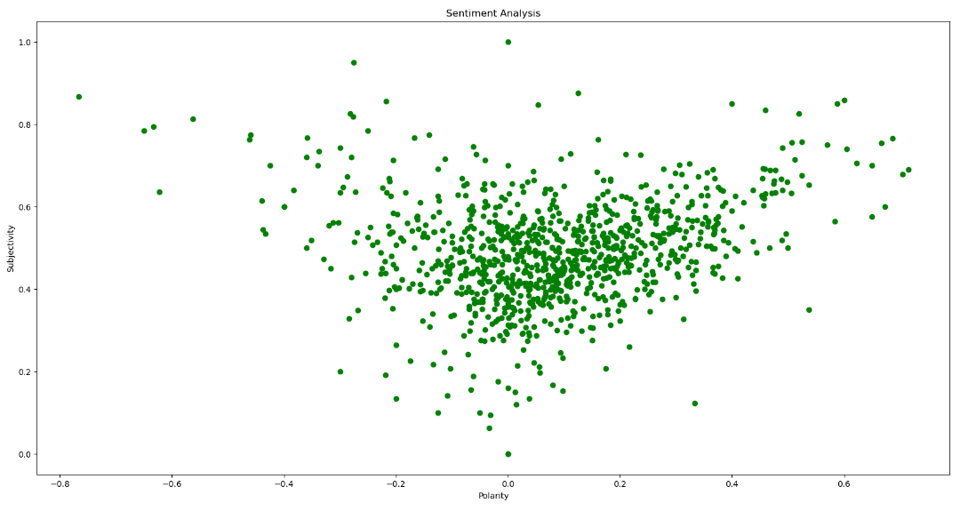
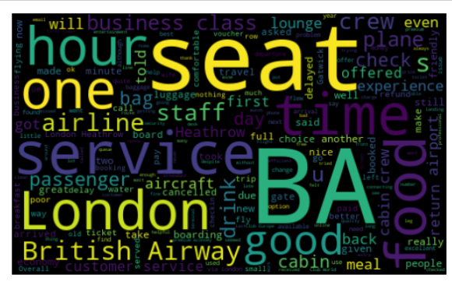
INSIGHTS FROM 1000 CUSTOMER REVIEWS
Graph Between Polarity And Subjectivity Bar Graph Of Sentiment Analysis
WORDCLOUD
Sentiment Of Reviews We Have Got From The Analysis
Positive Reviews: 673
Negative Reviews: 318
Neutral Reviews :9

